Slide 1
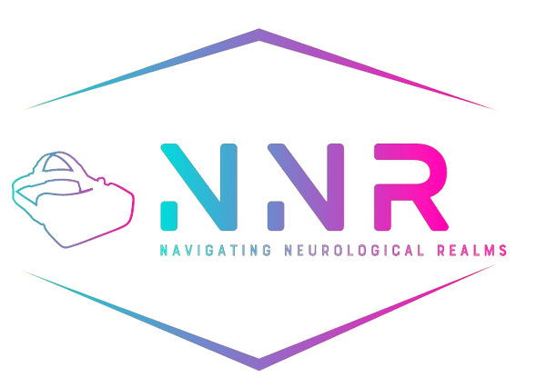

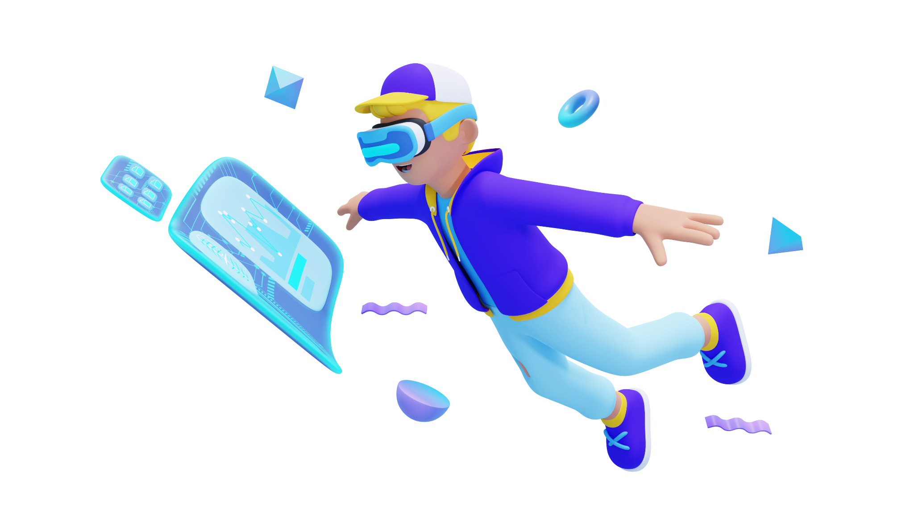
Capstone Project Phase B 24-1-D-28
Supervisors:
Dr. Anat Dahan
Dr. Marcela Viviana Karpuj
Students:
Michael Malka 311446231
Nir Asulin 305221483
01

Slide 2
TABLE OF CONTENTS
03 | Introduction
04 | Motivation
05 | System Requirements
06 | Our Solution
07 | CSV file analysis algorithm
08 | Technologies Used
09 | Demo
10 | Test Plan
11-14 | Results
15 | Our Key Achievements
16 | Challenges
17 | Future Work
02

Slide 3
Introduction
Parkinson's disease (PD) affects millions globally and is marked by tremors, slowness, stiffness, and instability.
Early diagnosis is difficult due to subtle symptoms, but motor asymmetry (more severe symptoms on one side) can signal early PD.
Our project uses VR technology to detect these early motor and cognitive impairments.
03

Slide 4
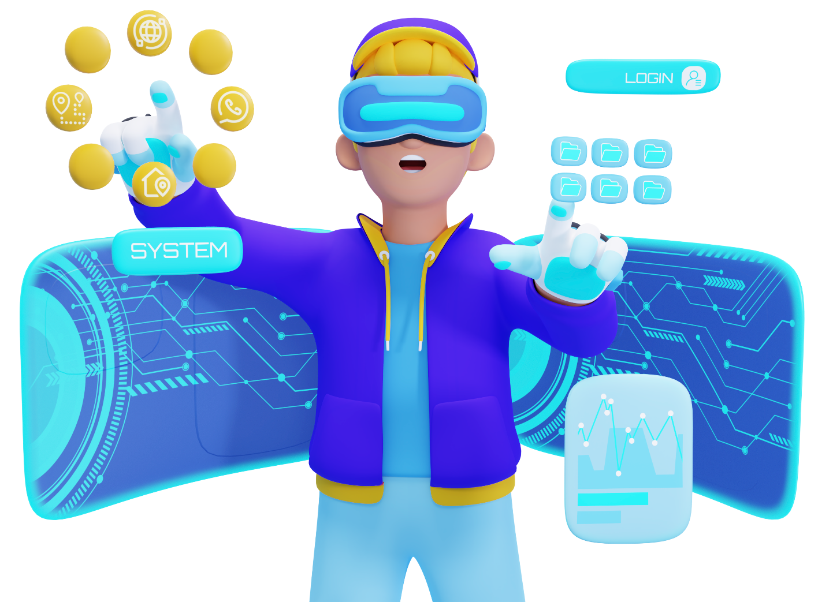
Motivation
Enhancing Neurological Healthcare through Technology
Enhance early diagnostic accuracy
Potential for use in other neurological diagnostics and rehabilitation
Improve patient experience in diagnostic experiences and compliance
04

Slide 5
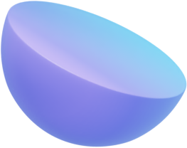
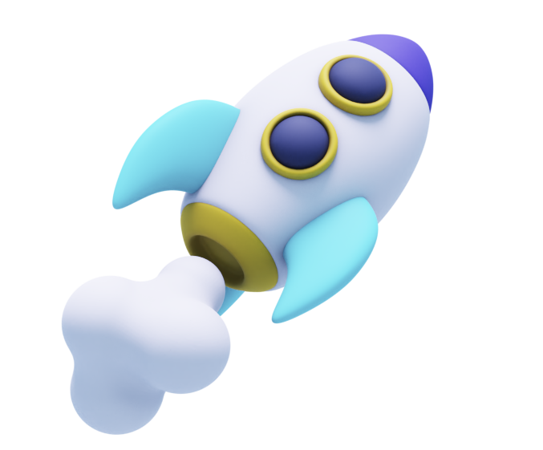

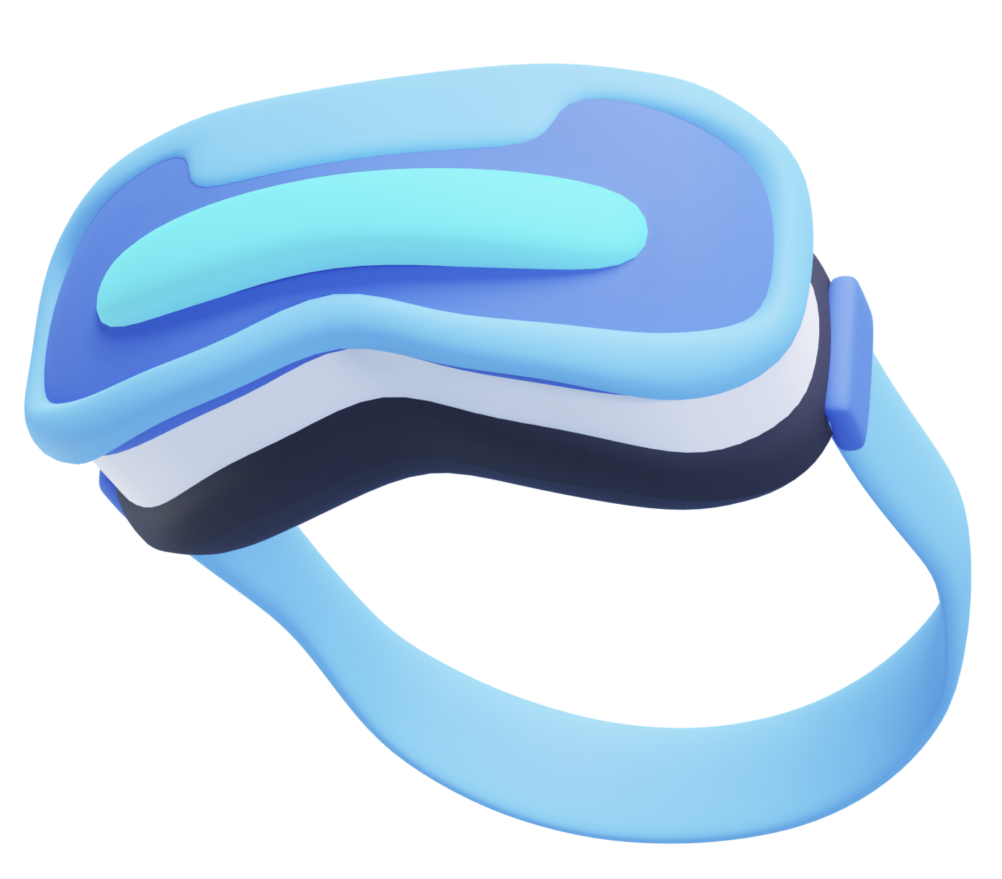
System Requirements
The system must detect hand movement asymmetry accurately during a virtual swimming task.
Data on hand movements (position, rotation, timing, velocity and stroke events) must be recorded for later analysis.
The interface should be user-friendly for both patients and clinicians, minimizing training time.
The system should run smoothly on the Oculus Quest 2 and provide real-time feedback during the test.
05

Slide 6
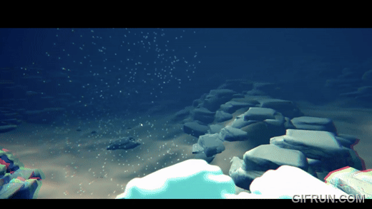
Our Solution
VR-Based Detection
VR system that tracks user movements, detecting asymmetries indicative of early PD.
Simulates swimming tasks using the Oculus Quest 2 and designed in Unity game engine.
Records data in CSV format for detailed analysis.
06

Slide 7

CSV file analysis algorithm
$IA=|\frac{L−R}{max⁡(L,R)}|×100$ ,L and R are the measurements of left and right hand, respectively.
$stroke_duration=timestamp\left(end_stroke\right)−timestamp(start_stroke)$
${IA}_{stroke}=|\frac{stroke_duration(left)−stroke_duration(right)}{max⁡(stroke_duration\left(left\right),stroke_duration(right))}$|
$mean_IA=\frac{\sum{IA}}{number of points}$
$threshold=α×mean_IA(for healthy individuals)$, threshold value for asymmetry.
$if mean_IA(patient>threshold)$, then the patient is considered to have asymmetry in that measurement.
07

Slide 8
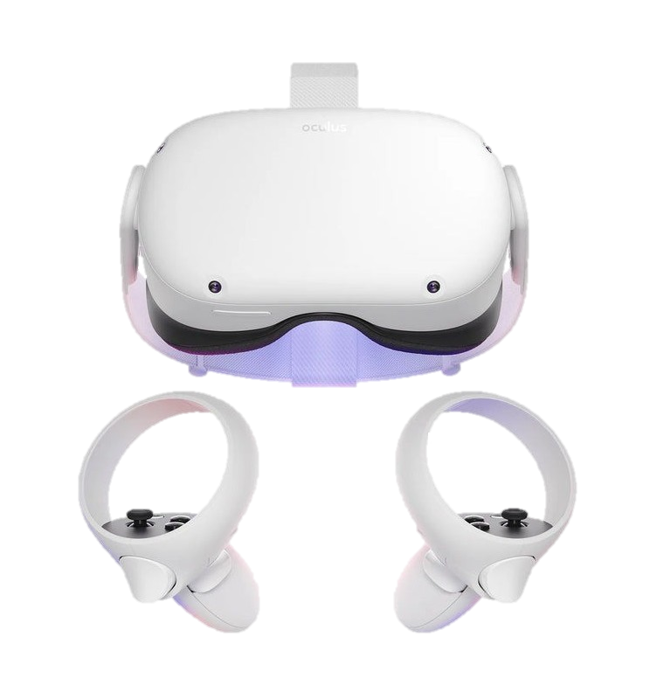



Technologies Used
Oculus Quest 2
VR hardware for immersive user interaction and hand-tracking capabilities.
Haptics for feedback during the swimming simulation.
Unity Game Engine
For creating the virtual reality environment and simulating hand movement.
Integration with the Oculus Quest 2 through the Oculus Integration SDK.
Visual Studio 2022
Development environment for coding and debugging Unity C# scripts.
Python (Google Colab)
Used for data analysis and post-processing of hand movement data (CSV files).
08

Slide 9
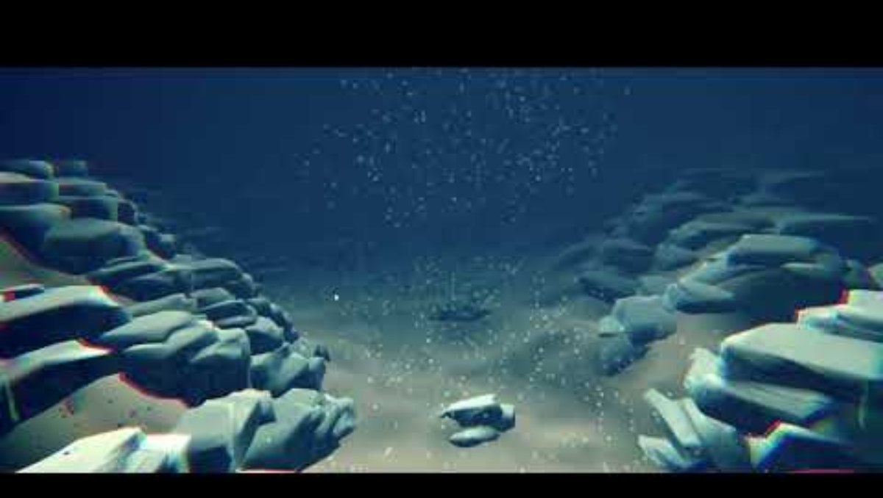
09

Slide 10

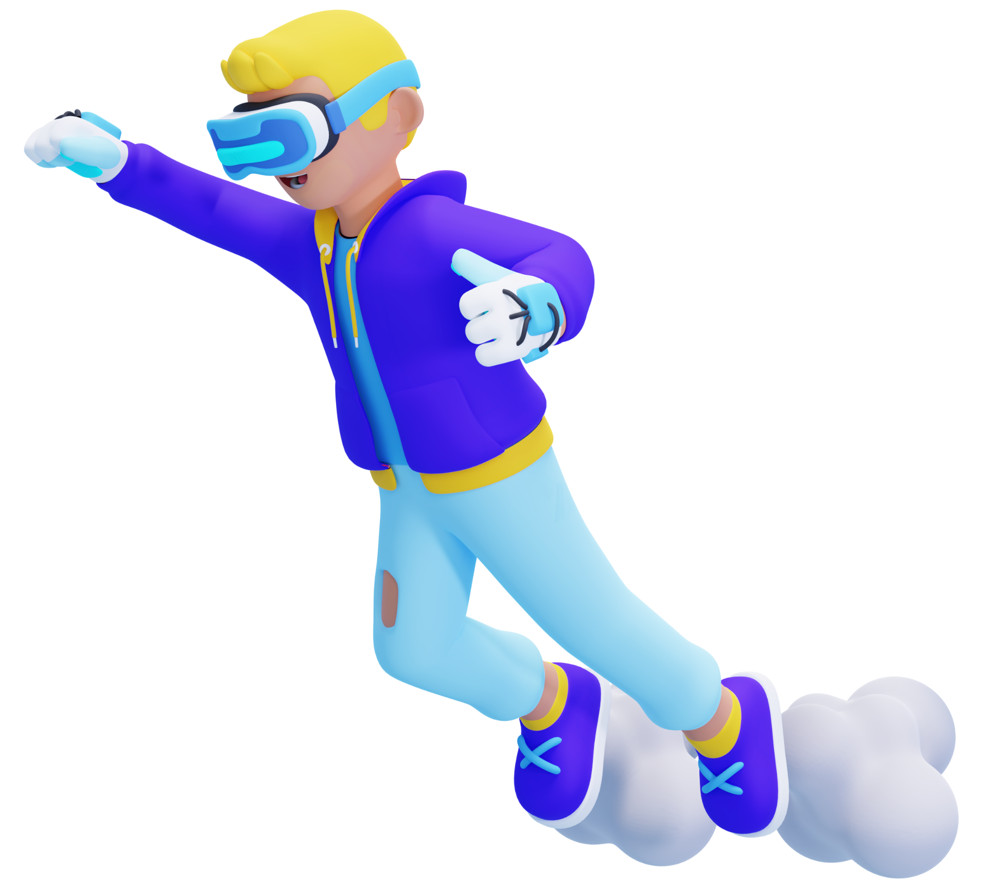
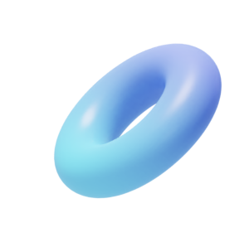
Test Plan
# | Test Case | Expected results | status
1 | VR_environment_launches | The VR environment should open successfully and be visible through the VR headset. | Pass
2 | User_input | User enters their name, and the “Start” button is enabled. | Pass
3 | Start_simulation | The timer is visible and counts down from 2 minutes during the simulation and start only when the first swimming motion is performed. | Pass
4 | Display_timer_in_simulation | The timer is visible and counts down from 2 minutes during the simulation and start only when the first swimming motion is performed. | Pass
5 | Hand_tracking_during_swimming | Hand movements are tracked in real-time without delays. | Pass
6 | Simulation_time_limit | The simulation ends automatically after 02:00 minutes, and swimming is no longer possible. | Pass
7 | System_performance | VR system operates smoothly with no frame drops or glitches. | Pass
8 | User_feedback | Users hear appropriate sound effects when interacting with the simulation (e.g., water entry and swimming motions). | Pass
9 | Save_data_to_CSV | The movement data (x y z positions, rotations etc) is successfully saved in a CSV file. | Pass
10 | CSV_file_import | The saved CSV file can be successfully imported and used for analysis. | Pass
10

Slide 11
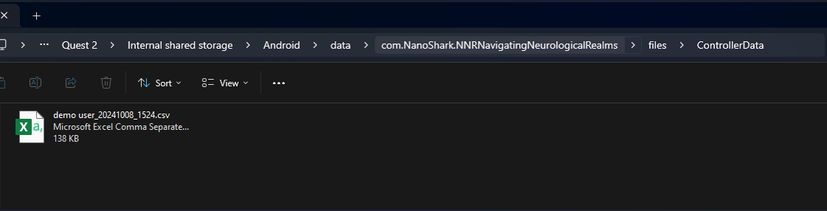
Results
- The CSV saved in Quest 2, Then we export it into the computer
- The name “demo user” is saved with the current date and time “2024/10/08 at 15:24”
11

Slide 12
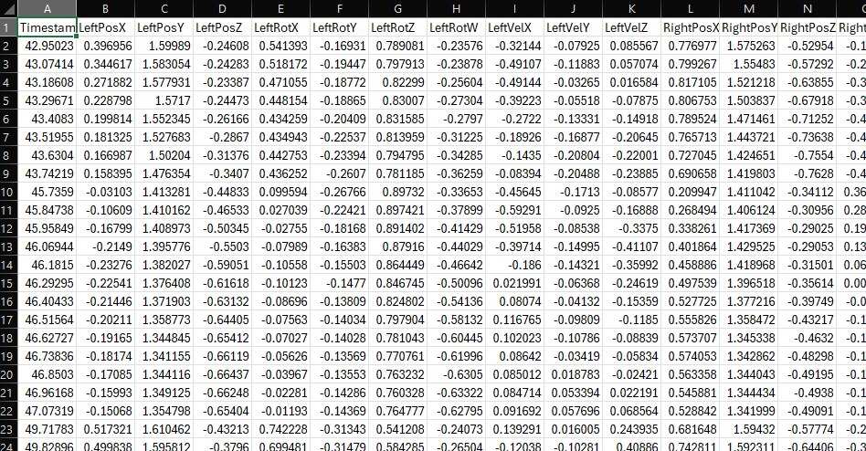
Results
CSV Recording of Demo User
12

Slide 13
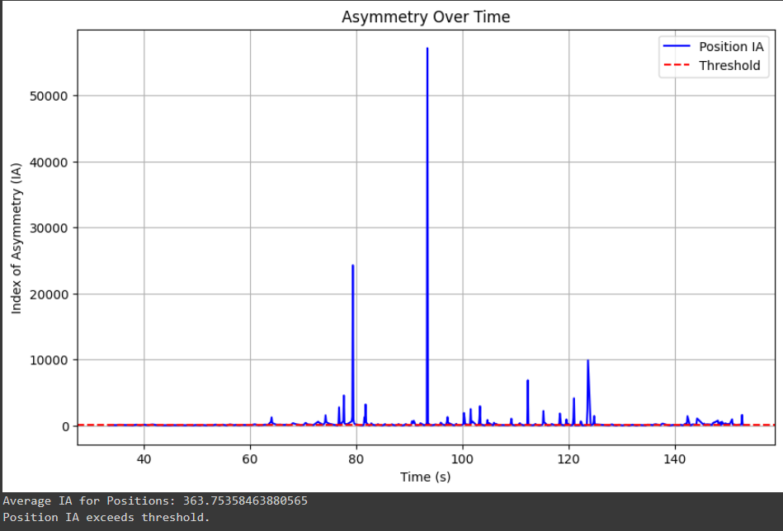
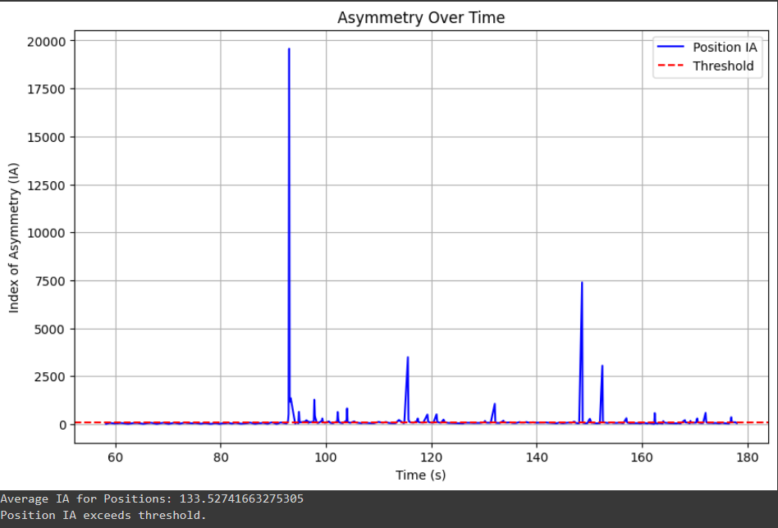
Results
First Asymmetry Test
Second Asymmetry Test
Both tests exceed the threshold suggesting that the test subjects may be at risk for PD
13

Slide 14
Results
Threshold Visualization:
Blue line: Subject's IA values
Red dashed line: Healthy threshold
IA Comparison:
Subject's IA values for hand positions are significantly higher than healthy thresholds.
Persistent Asymmetry:
Elevated IA values sustained across time during the simulation.
Diagnostic Insight:
Indicates notable hand movement asymmetry—key marker for potential motor impairment.
14

Slide 15
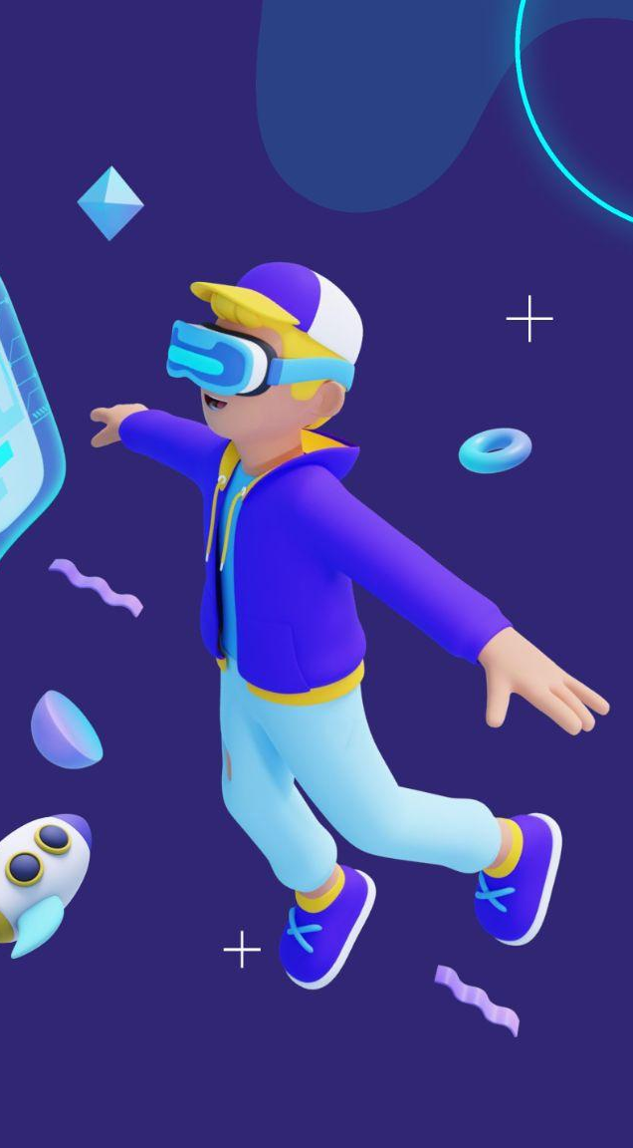
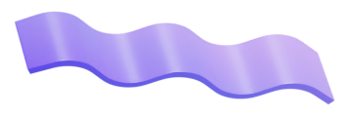
Our Key Achievements
VR Diagnostic Tool
Automated Data Capture & Analysis
Created a VR system simulating swimming actions for detecting subtle motor asymmetries, early indicators of PD.
Built with Oculus Quest 2 and Unity for a responsive and immersive diagnostic experience.
Captures and analyzes movement data for PD markers.
User-Centric Design
Intuitive, comfortable VR experience for accurate diagnostics.
Movement Analysis Algorithm
Real-time hand movement tracking, calculating the Index of Asymmetry (IA).
15

Slide 16
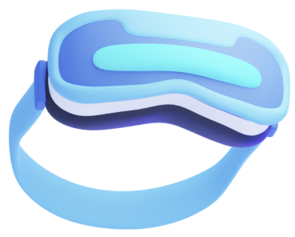
Challenges
Data Collection Bugs
Collider Implementation
Optimization for Oculus Quest 2
Early issues with capturing precise movement data (timestamps, positions, rotations) in CSV files. Resolved through debugging.
Added colliders and boundaries to prevent users from passing through objects or leaving the virtual environment.
Simplified materials, adjusted graphics quality, and optimized scene rendering for smooth performance on the Quest 2.
16

Slide 17
Future Work
Enhanced Simulation
Add sea animals and water conditions for realism and better data.
Hand-Tracking
Use hand tracking for more precise measurements.
Real Time Feedback Provide immediate feedback with visual cues and haptics.
Machine Learning
Apply AI to improve disease prediction.
Expanded Research
Test with more patients and study other diseases.
Wearables
Integrate devices to track more physiological data.
Improved Algorithm Make asymmetry detection more accurate.
Cloud Storage
Enable secure, remote access to data for collaboration.
17

Slide 18

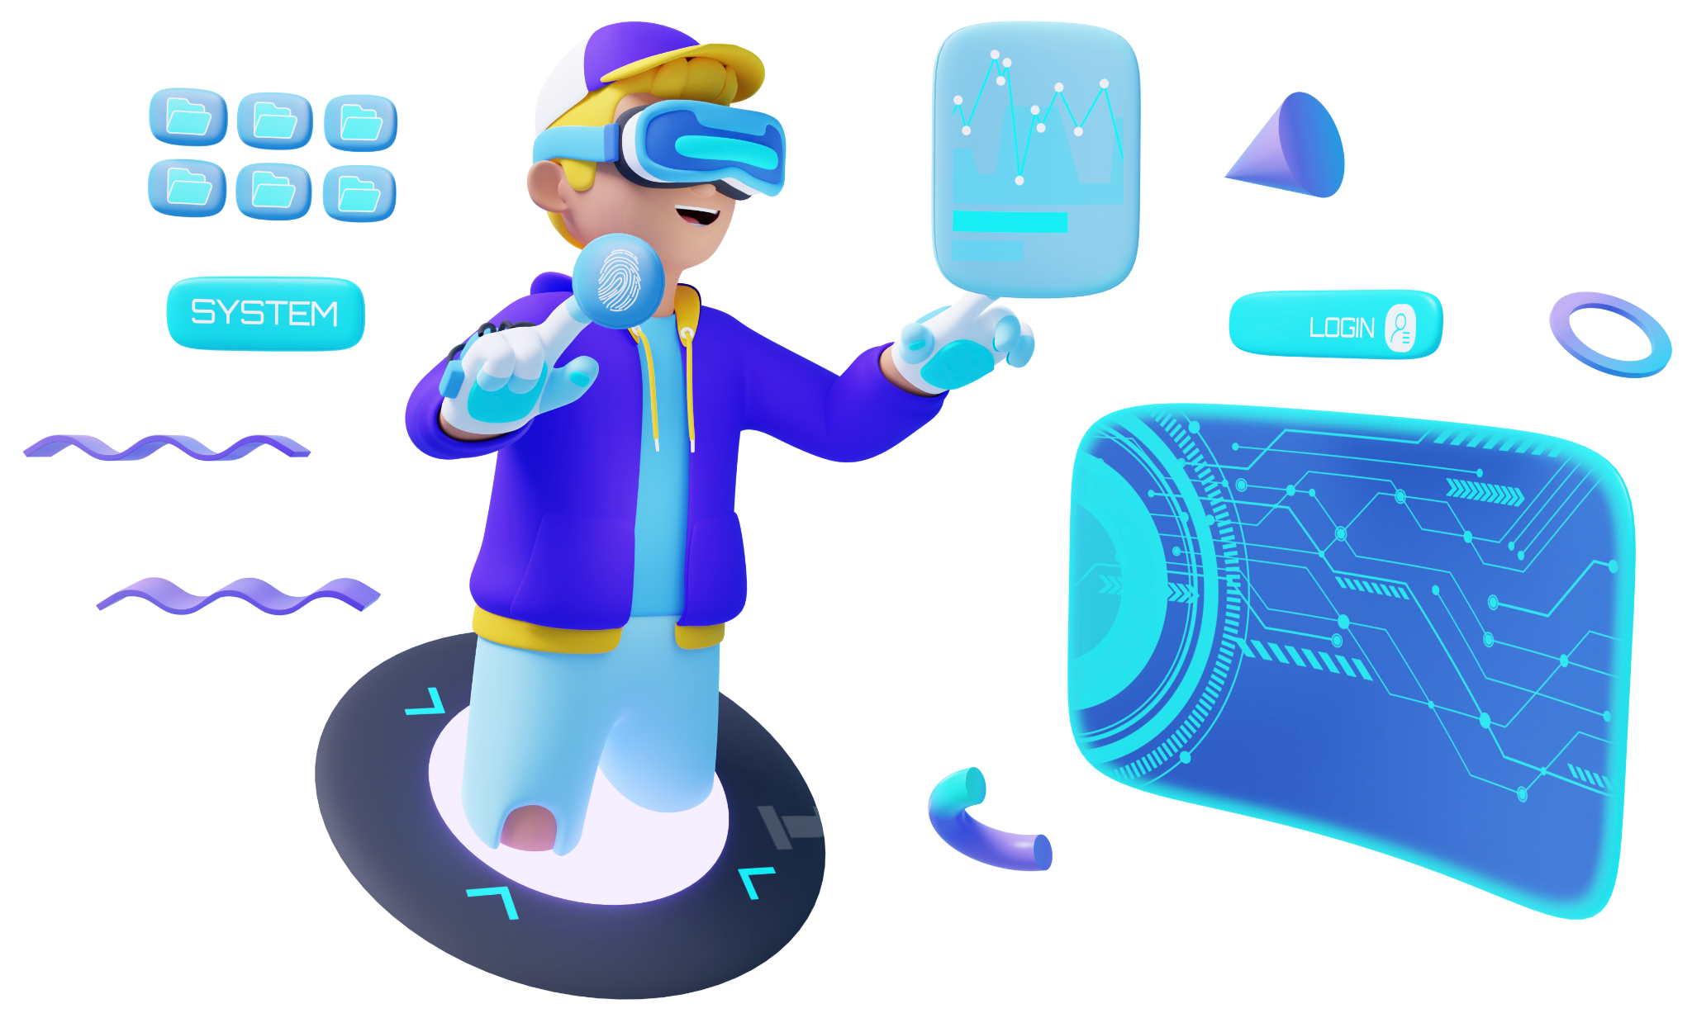
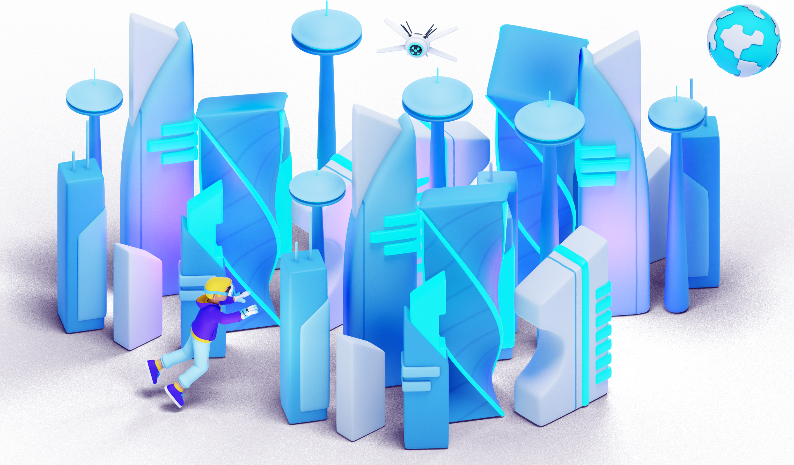
Any Questions?
18

Slide 19

Thank You For Listening
Github Repository
19

